Slide 1
Course Theme: Abstraction vs. Reality
Professor Hugh C. Lauer CS-2011, Machine Organization and Assembly Language
(Slides include copyright materials from Computer Systems: A Programmer’s Perspective, by Bryant and O’Hallaron, and from The C Programming Language, by Kernighan and Ritchie)

Slide 2
Course Theme: Abstraction is good but don’t forget reality
Most CS courses emphasize abstraction
Abstract data types
Asymptotic analysis
Abstractions have limits
Especially in the presence of bugs
Need to understand details of underlying implementations
Useful outcomes
Become more effective programmers
Able to find and eliminate bugs efficiently
Able to understand and tune for program performance
Prepare for later “systems” classes in CS & ECE
Compilers, Operating Systems, Networks, Computer Architecture, Embedded Systems

Slide 3
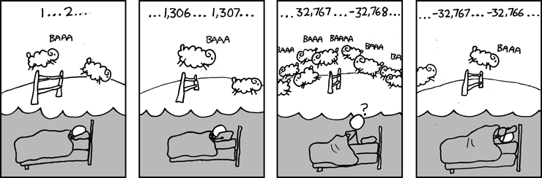
Great Reality #1: Ints are not integers, floats are not reals
Example 1: Is x² ≥ 0?
Float’s: Yes!
Int’s:
40000 * 40000 ➙ 1,600,000,000
50000 * 50000 ➙ ??
Example 2: Is (x + y) + z = x + (y + z)?
Unsigned & Signed Int’s: Yes!
Float’s:
(1e20 + -1e20) + 3.14 --> 3.14
1e20 + (-1e20 + 3.14) --> ??
-352,516,352
Source: xkcd.com/571

Slide 4
Code security example
/* Kernel memory region holding user-accessible data */
#define KSIZE 1024
char kbuf[KSIZE];
/* Copy at most maxlen bytes from kernel region to user buffer */
int copy_from_kernel(void *user_dest, int maxlen) {
/* Byte count len is minimum of buffer size and maxlen */
int len = KSIZE < maxlen ? KSIZE : maxlen;
memcpy(user_dest, kbuf, len);
return len;
}
Similar to code found in FreeBSD’s implementation of getpeername()
There are legions of smart people trying to find vulnerabilities in programs

Slide 5
Typical usage
/* Kernel memory region holding user-accessible data */
#define KSIZE 1024
char kbuf[KSIZE];
/* Copy at most maxlen bytes from kernel region to user buffer */
int copy_from_kernel(void *user_dest, int maxlen) {
/* Byte count len is minimum of buffer size and maxlen */
int len = KSIZE < maxlen ? KSIZE : maxlen;
memcpy(user_dest, kbuf, len);
return len;
}
#define MSIZE 528
void getstuff() {
char mybuf[MSIZE];
copy_from_kernel(mybuf, MSIZE);
printf("%s\n", mybuf);
}

Slide 6
Malicious usage
/* Kernel memory region holding user-accessible data */
#define KSIZE 1024
char kbuf[KSIZE];
/* Copy at most maxlen bytes from kernel region to user buffer */
int copy_from_kernel(void *user_dest, int maxlen) {
/* Byte count len is minimum of buffer size and maxlen */
int len = KSIZE < maxlen ? KSIZE : maxlen;
memcpy(user_dest, kbuf, len);
return len;
}
#define MSIZE 528
void getstuff() {
char mybuf[MSIZE];
copy_from_kernel(mybuf, -MSIZE);
. . .
}
This line turns out to be toxic!

Slide 7
Computer arithmetic
Does not generate random values
Arithmetic operations have important mathematical properties
Cannot assume all “usual” mathematical properties
Due to finiteness of representations
Integer operations satisfy “ring” properties
Commutative, associative, distributive
Floating point operations satisfy “ordering” properties
Monotonicity, values of signs
Observation
Need to understand which abstractions apply in which contexts
Important issues for compiler writers and serious application programmers

Slide 8
Great Reality #2: You’ve got to know assembly language
Chances are, you’ll never write programs in assembly
Compilers are much better & more patient than you are
But: Understanding assembly is key to machine-level execution model
Behavior of programs in presence of bugs
High-level language models break down
Tuning program performance
Understand optimizations done / not done by the compiler
Understanding sources of program inefficiency
Implementing system software
Compiler has machine code as target
Operating systems must manage process state
Creating / fighting malware
x86 assembly is the language of choice!

Slide 9
Assembly code example
Time Stamp Counter
Special 64-bit register in Intel-compatible machines
Incremented every clock cycle
Read with rdtsc instruction
Application
Measure time (in clock cycles) required by procedure
double t;
start_counter();
P();
t = get_counter();
printf("P required %f clock cycles\n", t);

Slide 10
Code to read counter
Write small amount of assembly code using GCC’s asm facility
Inserts assembly code into machine code generated by compiler
static unsigned cyc_hi = 0;
static unsigned cyc_lo = 0;
/* Set *hi and *lo to the high and low order bits
of the cycle counter.
*/
void access_counter(unsigned *hi, unsigned *lo)
{
asm("rdtsc; movl %%edx,%0; movl %%eax,%1"
: "=r" (*hi), "=r" (*lo)
:
: "%edx", "%eax");
}
Notes:
GCC Extended assembly syntax
asm( assembler syntax
: output operands /*optional */
: input operands /* optional */
: list of clobbered registers /* optional */
);

Slide 11
Great Reality #3: Memory matters Random access memory is an unphysical abstraction
Memory is not unbounded
It must be allocated and managed
Many applications are memory dominated
Memory referencing bugs especially pernicious
Effects are distant in both time and space
Memory performance is not uniform
Cache and virtual memory effects can greatly affect program performance
Adapting program to characteristics of memory system can lead to major speed improvements

Slide 12
Memory referencing bug example
double fun(int i)
{
volatile double d[1] = {3.14};
volatile long int a[2];
a[i] = 1073741824; /* Possibly out of bounds */
return d[0];
}
fun(0) ➙ 3.14
fun(1) ➙ 3.14
fun(2) ➙ 3.1399998664856
fun(3) ➙ 2.00000061035156
fun(4) ➙ 3.14, then segmentation fault
Result is architecture specific

Slide 13
Memory referencing bug example
double fun(int i)
{
volatile double d[1] = {3.14};
volatile long int a[2];
a[i] = 1073741824; /* Possibly out of bounds */
return d[0];
}
fun(0) ➙ 3.14
fun(1) ➙ 3.14
fun(2) ➙ 3.1399998664856
fun(3) ➙ 2.00000061035156
fun(4) ➙ 3.14, then segmentation fault
Explanation:
Saved State | 4
d7 ... d4 | 3
d3 ... d0 | 2
a[1] | 1
a[0] | 0
Location accessed by fun(i)

Slide 14
Memory referencing errors
C and C++ do not provide any memory protection
Out of bounds array references
Invalid pointer values
Abuses of malloc()/free()
Can lead to nasty bugs
Whether or not bug has any effect depends on system and compiler
Action at a distance
Corrupted object logically unrelated to one being accessed
Effect of bug may be first observed long after it is generated
How can I deal with this?
Program in Java, Ruby. or ML
Understand what possible interactions may occur
Use or develop tools to detect referencing errors (e.g. Valgrind)

Slide 15
Great Reality #4: More to performance than asymptotic complexity
Constant factors matter too!
And even exact op count does not predict performance
Easily see 10:1 performance range depending on how code written
Must optimize at multiple levels: algorithm, data representations, procedures, and loops
Must understand system to optimize performance
How programs compiled and executed
How to measure program performance and identify bottlenecks
How to improve performance without destroying code modularity and generality

Slide 16
Memory system performance example
void copyij(int src[2048][2048],
int dst[2048][2048])
{
int i,j;
for (i = 0; i < 2048; i++)
for (j = 0; j < 2048; j++)
dst[i][j] = src[i][j];
}
void copyji(int src[2048][2048],
int dst[2048][2048])
{
int i,j;
for (j = 0; j < 2048; j++)
for (i = 0; i < 2048; i++)
dst[i][j] = src[i][j];
}
21 times slower (Pentium 4)
Hierarchical memory organization
Performance depends on access patterns
Including how step through multi-dimensional array

Slide 17
The Memory Mountain
Intel Core i7
2.67 GHz
32 KB L1 d-cache
256 KB L2 cache
8 MB L3 cache
Fig 6.41 p. 641

Slide 18
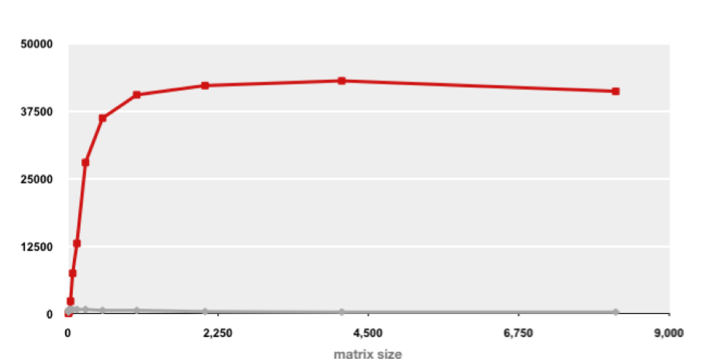
Example Matrix Multiplication
Matrix-Matrix Multiplication (MMM) on 2 x Core 2 Duo 3 GHz (double precision)
Gflop/s
Best code (K. Goto)
160x
Triple loop
Standard desktop computer, vendor compiler, using optimization flags
Both implementations have exactly the same operations count (2n³)
What is going on?

Slide 19
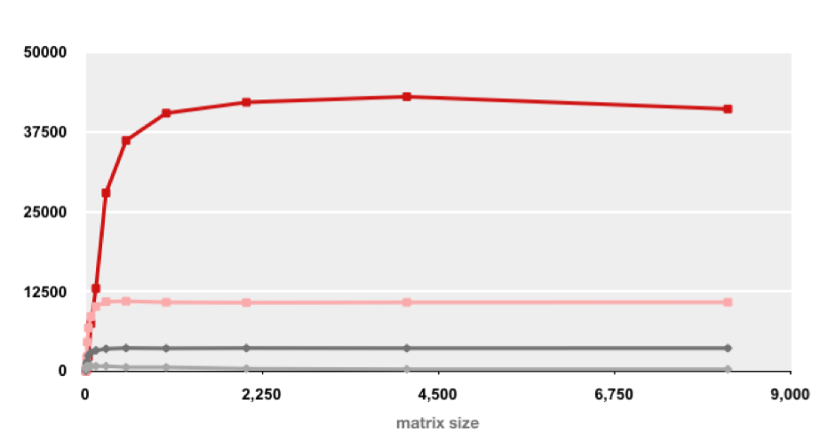
MMM Plot: Analysis
Matrix-Matrix Multiplication (MMM) on 2 x Core 2 Duo 3 GHz
Gflop/s
Multiple threads: 4x
Vector instructions: 4x
Memory hierarchy and other optimizations: 20x
Reason for 20x: Blocking or tiling, loop unrolling, array scalarization, instruction scheduling, search to find best choice
Effect: fewer register spills, L1/L2 cache misses, and TLB misses

Slide 20
Great Reality #5: Computers do more than execute programs
They need to get data in and out
I/O system critical to program reliability and performance
They communicate with each other over networks
Many system-level issues arise in presence of network
Concurrent operations by autonomous processes
Coping with unreliable media
Cross platform compatibility
Complex performance issues

Slide 21
Questions? Comments?

